Slide 1
SILABUS DAN SAP
MK SEJARAH PERADABAN DAN KEBUDAYAAN TURKI

Slide 2
APA YANG ANDA KETAHUI TENTANG TURKI?
KEBAB?
TEH TURKI?
KOPI TURKI?
MUSTAFA KEMAL ATATÜRK?
MUSEUM HAGIA SOPHIA?
ERDOĞAN?
SINETRON TURKI?

Slide 3
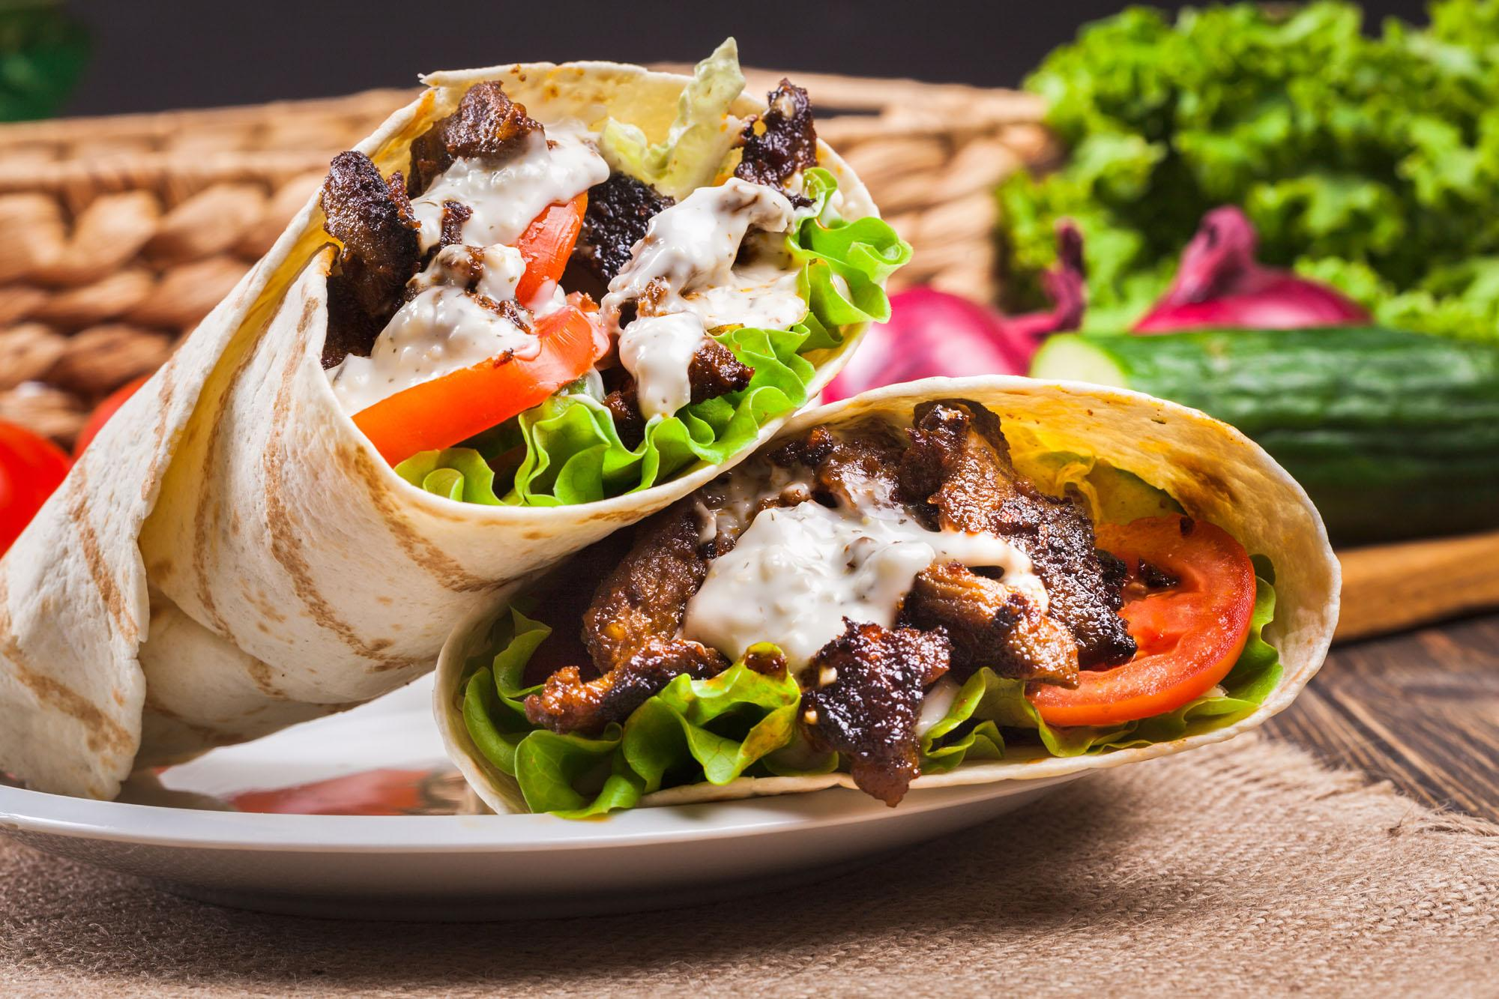
KEBAB?

Slide 4
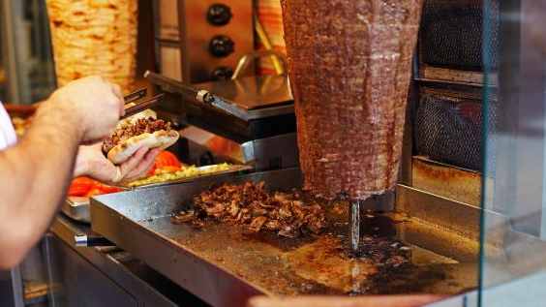
DÖNER KEBAB

Slide 5
APA BEDA KEBAB TURKI DAN KEBAB TURKI ALA INDONESIA?
Di Turki, kebab adalah daging yang dimasak sebelum akhirnya disajikan dengan berbagai cara. Salah satu penyajiannya adalah dengan dibungkus roti pita.
Di Timur Tengah, daging yang disajikan bersama sayuran lalu dibungkus roti ini disebut Shawarma.
Kebab Turki ALA Indonesia, biasanya berupa daging sapi yang dipanggang lalu dicampur sayuran, kemudian dibungkus dengan roti pita.
Kebab Turki ala Indonesia disebut Shawarma (Döner).

Slide 6
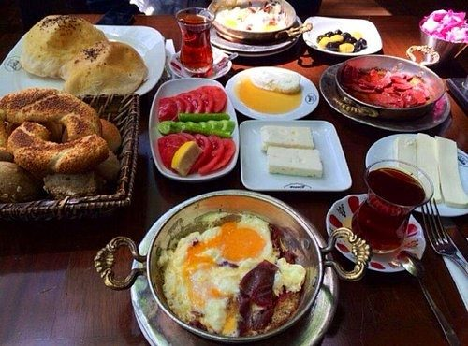

Slide 7
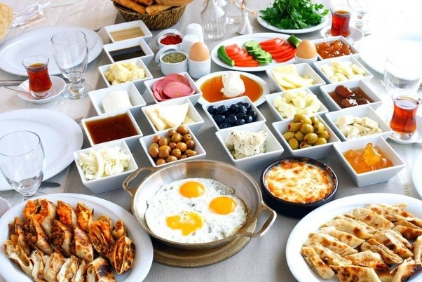
“Kahvaltı” (breakfast, prior to coffee”)

Slide 8
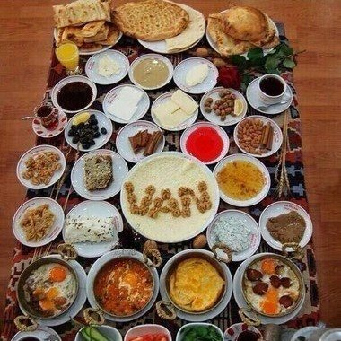
Gaziantep has its breakfast speciality of katmer, a pie with pistachio and cream.

Slide 9
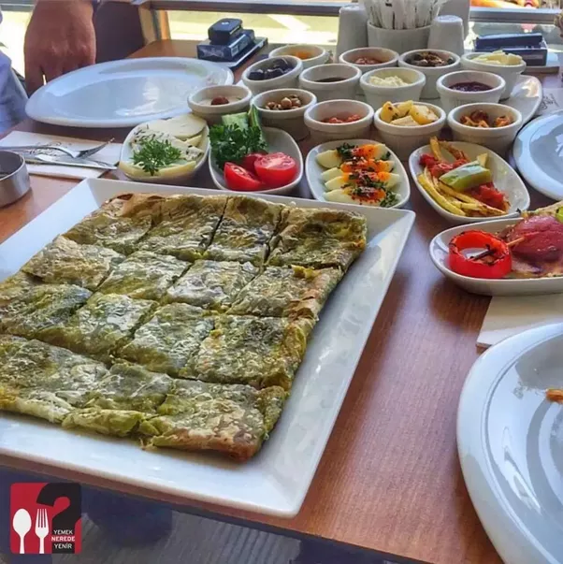
Şanlıurfa’s liver kebab breakfast

Slide 10
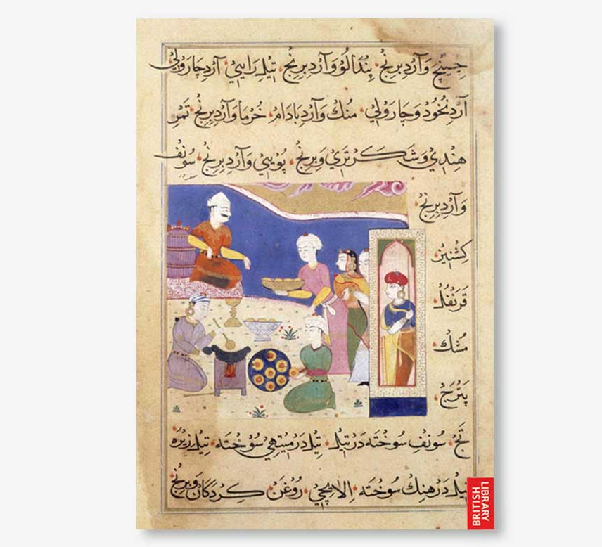
SAMOSA
SAMSA = PIRAMID

Slide 11
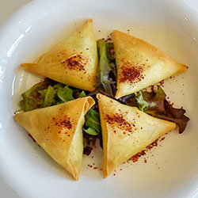
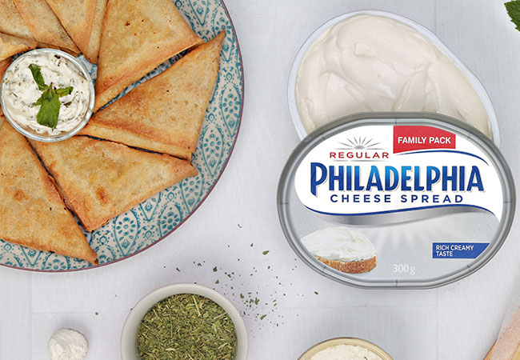
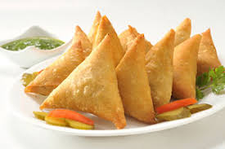
SAMOSA

Slide 12
BERASAL DARI MANAKAH SAMOSA INI?
Makanan ringan berisi daging, bayam, keju, ditambah rempah ini diperkirakan berasal dari Asia Tengah sebelum abad ke-10 dan diperkenalkan di seluruh kawasan Asia pada abad ke-13 oleh kalangan pedagang dan pelaut yang kala itu banyak berinteraksi dengan pelabuhan dan Kesultanan Delhi (1206 – 1526).
Teori lain:
Samosa berusia lebih tua daripada itu, yakni berasal dari Dinasti Ghaznavid (977 – 1186).

Slide 13
AMIR KHUSRO (1253-1325), PENYAIR DAN CENDEKIAWAN KESULTANAN DELHI
Abolfazl Beyhaqi (995-1077), sejarawan Iran, Tarikh-e-Beyhaghi
Kaum bangsawan sangat menyukai makanan berbentuk segitiga berisi daging, minyak samin, bawang bombay, dan rempah lainnya.
Samosa dibawa oleh para pedagang India pada abad ke-13 atau 14.

Slide 14
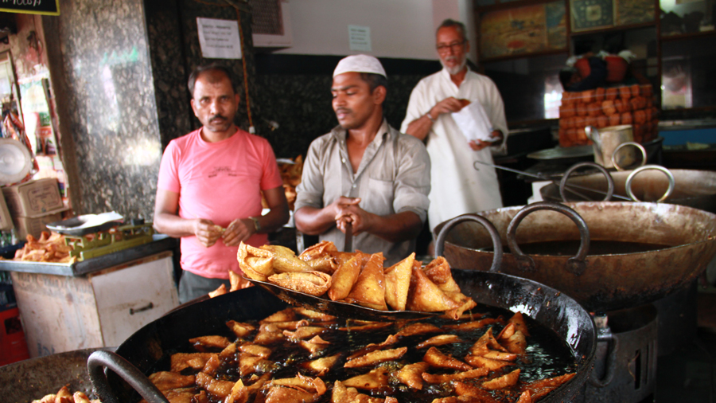

Slide 15
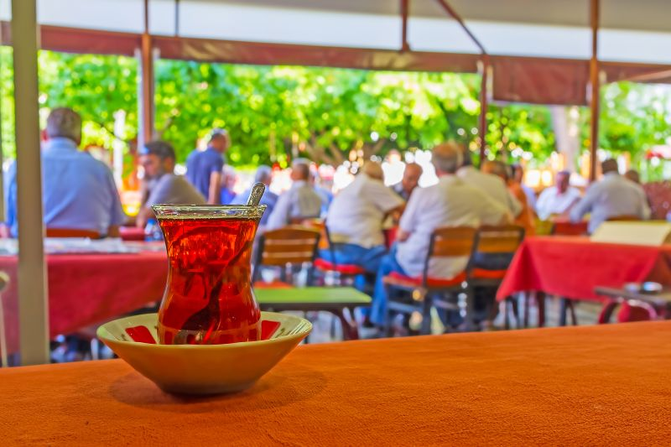
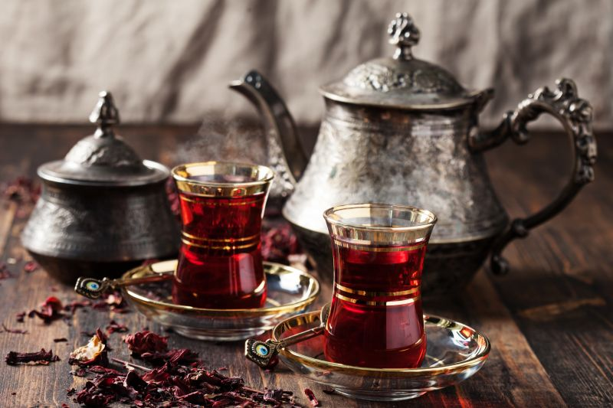
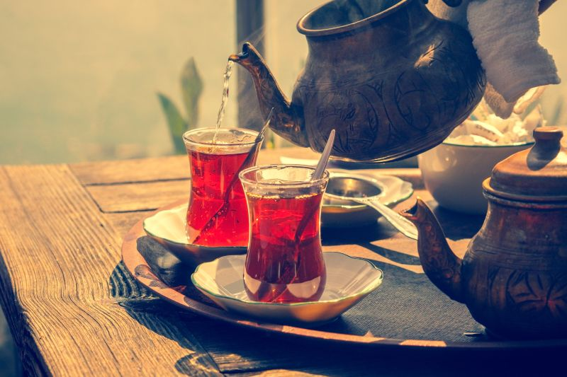
TEH TURKI

Slide 16
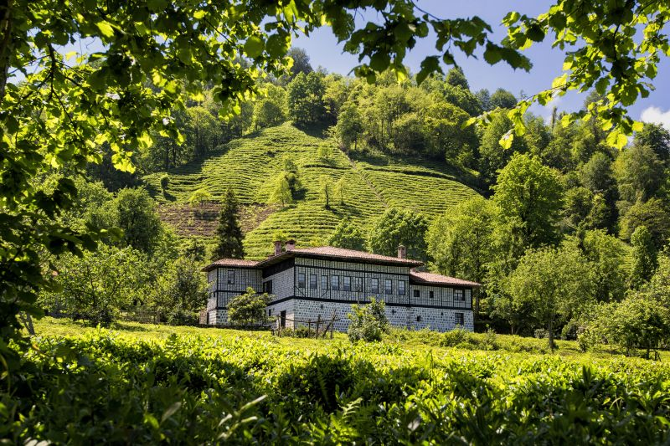

Slide 17
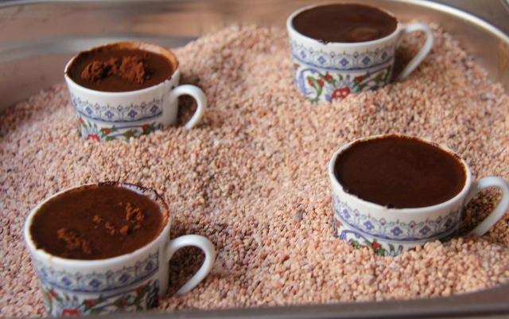
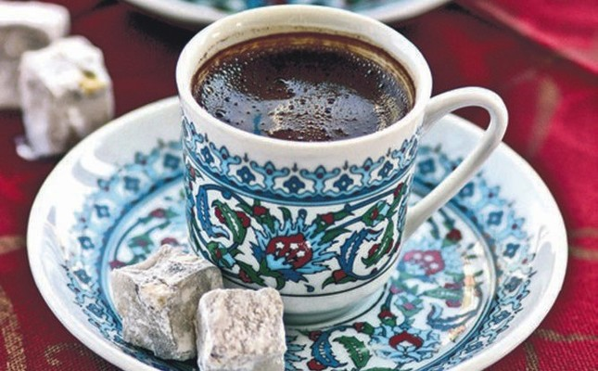
KOPI TURKI

Slide 18
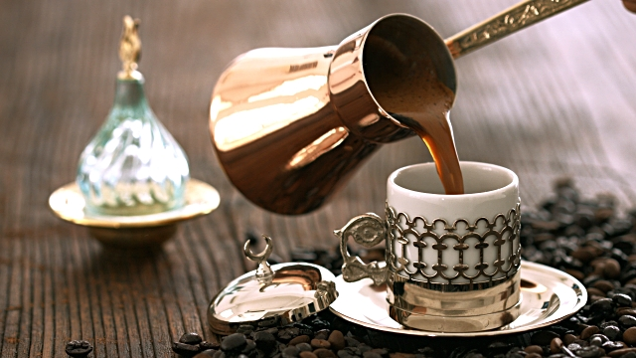

Slide 19
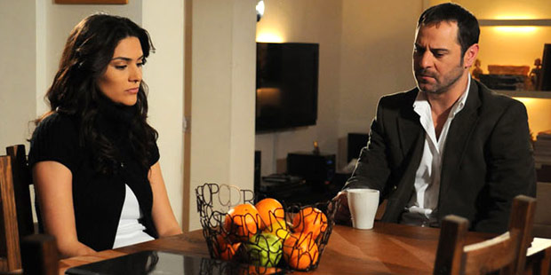
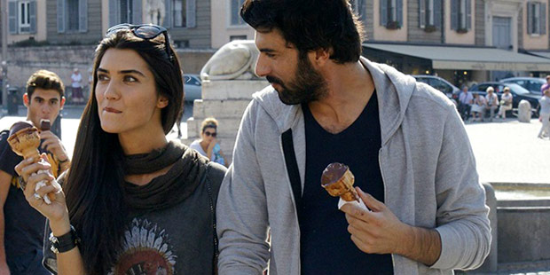
SINETRON TURKI

Slide 20
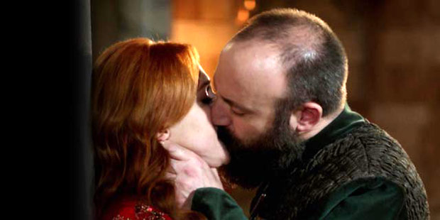
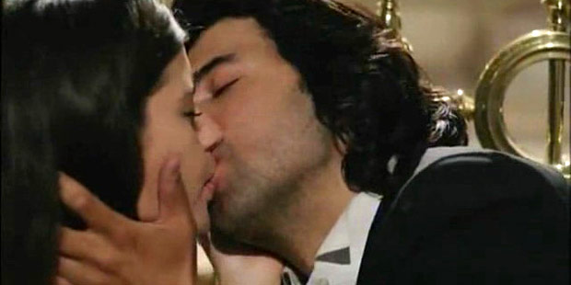
TURKISH OPERA SOAP

Slide 21
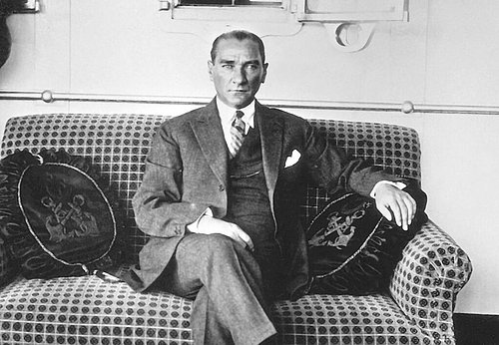
FATHER OF THE TURKS

Slide 22
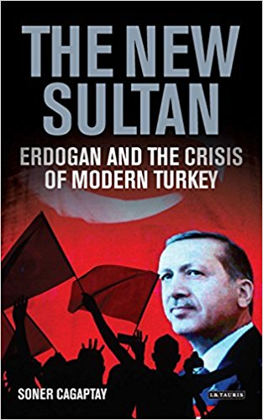
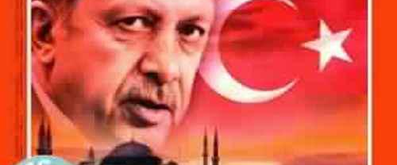

Slide 23
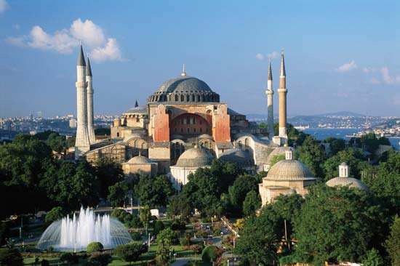
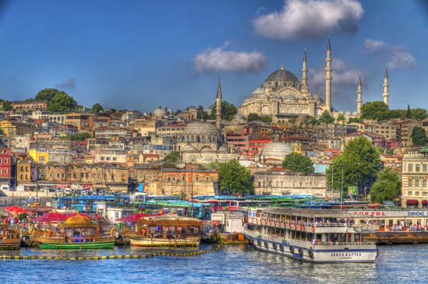
HAGIA SOPHIA

Slide 24
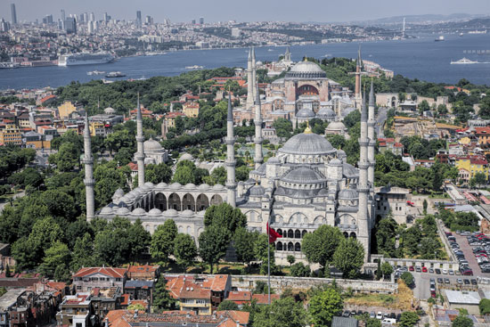

Slide 25
AFRASYAB, KING OF THE TURKS
‘THE TURK IS LIKE A PEARL IN ITS SHELL AT THE BOTTOM OF THE SEA, WHICH ONLY BECOMES VALUABLE WHEN IT LEAVES THE SEA AND ADORNS THE DIADEMS OF THE KINGS AND THE EARS OF BRIDES.’

Slide 26
MENGAPA BELAJAR SEJARAH PERADABAN DAN KEBUDAYAAN TURKI?
ARE YOU INTERESTED IN CLASS-ROOM WHICH EXPLORE THE TURKS FROM THE VIEWPOINTS OF THEIR HISTORY, THEIR GEOGRAPHY, THEIR MYTHS AND STORIES, THEIR LITERATURE, THEIR ART AND ARCHITECTURE, AND THEIR CULTURAL HERITAGE?

Slide 27
‘FROM THE DAYS OF ADAM DOWN TO THE PRESENT DAY NO SLAVE BOUGHT AT A PRICE HAS EVER BECOME THE KING EXCEPT AMONG THE TURKS’

Slide 28
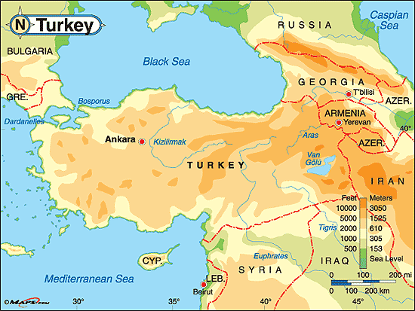
A PHYSICAL MAP OF TURKEY

Slide 29
The contribution of the peoples of the area to history and the role of the Turks not only in Turkish history, but also in Central Asia, Western China, Eastern Europe, and Russia.

Slide 30
TURKISH STUDIES
Is teaching about Turkey currently a major priority in world and global history courses?

Slide 31

1290-1922
DARI SISI DURASI DAN LUAS WILAYAH KEKUASAAN TIDAK ADA SATU PUN KERAJAAN ISLAM YANG DAPAT MENANDINGI NEGARA OTTOMAN.
1
LAMA KEKUASAANN DINASTI INI SAMA DENGAN HABSBURG EMPIRE.
2
WILAYAH TERBENTANG DARI ...
3

Slide 32
KAWASAN ATLANTIK SAMPAI EUFRAT
DARI PADANG SABANA RUSIA SAMPAI SAHARA
MELIPUTI DAERAH-DAERAH PUSAT KEKUASAAN DUNIA ISLAM
DARI ARAH TENGGARA LAUT HITAM MELALUI IRAK SAMPAI HIJAZ: SYRIA, PALESTINA DAN MESIR

Slide 33
DESKRIPSI MATA KULIAH
Mata kuliah ini memberikan kemampuan kepada mahasiswa untuk dapat:
1. Menjelaskan sejarah dan latar belakang peradaban dan kebudayaan Turki sejak migrasi dari Asia Tengah ke Eropa (Eurasia)
2. Dinasti-Dinasti Islam Turki Pertama
3. Dinasti Seljuk Raya dan Dinasti Seljuk Rum
4. Konfederasi Negara-Negara Turki
5. The 3 gunpowder dynasties : Negara Ottoman (Osmanli Devleti), Dinasti Mughal, Dinasti Safavid) sampai jatuhnya Negara Ottoman.

Slide 34

Dengan menerapkan aktivitas belajar seperti interactive learning, cooperative learning, small group discussion, discovery learning, dan individual report reading, ruang lingkup yang dibahas meliputi:

Slide 35
1. Penelusuran kehidupan di stepa Eurasia (Eropa-Asia Tengah), Dinasti-Dinasti Turki pra-Islam (Hun, Gökturk, Uyghur dan Öghuz)
2. Pergolakan sosial politik masa Dinasti-dinasti Islam Turki pertama
3. Konfederasi Negara-Negara Turki
4. Dinasti Seljuk Raya dan Kesultanan Seljuk Rum
5. Dinasti Mamluk
6. Negara Ottoman (Osmanli Devleti) I, II, dan III
7. Pengaruh kebudayaan Turki pada konteks global.
Bahasa pengantar yang digunakan adalah bahasa Indonesia dan bahasa Inggris.

Slide 36
KOMPETENSI
Setelah mengikuti mata kuliah ini, diharapkan mahasiswa:
Dapat menjelaskan sejarah dan latar belakang peradaban dan kebudayaan Turki;
Dapat menjelaskan sejarah dan peradaban yang dihasilkan pada masa Turki pra-Islam, Negara-negara Islam Turki Pertama;
Dapat memaparkan sejarah Negara Ottoman sampai Perang Dunia I;
Dapat menjelaskan pengaruh peradaban Turki pada konteks global.

Slide 37
EVALUASI
Penilaian nonujian tetap menjadi persyaratan untuk mengikuti ujian yaitu jumlah kehadiran 80 % dari keseluruhan jumlah tatap muka (16 minggu x 3 = 48, dikurangi 2 minggu (UTS dan UAS), dikurangi libur 2 minggu = 36 tatap muka
Batas ketidakhadiran maksimal 3 minggu (3 x 3 jam)
LEBIH DARI ITU, TIDAK DIPERKENANKAN MENGIKUTI UAS, TIDAK LULUS.
MOHON MAAF YAAA MAS BRO N MBAK SIST ...

Slide 38
PERHATIAN !!!
JANGAN TERLAMBAT MASUK KELAS YAAAA!!!
JANGAN NGOBROL DAN BISIK-BISIK DI KELAS JUGA YAAAA!!!
JANGAN PAMER GADGET DI KELAS
JANGAN WHATSAPPS-AN, FB-AN, LINE-AN, SMS-AN, EMAIL2-AN, INSTAGRAM-AN, CUIT-CUIT-AN, HASHTAG-AN ...

Slide 39
NO TEXTING
NO DIALING
NO HAND-HELD CELL PHONE WHILE STUDYING
IT’S THE LAW!

Slide 40
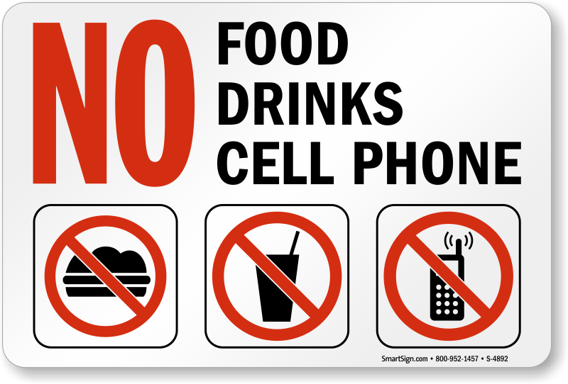

Slide 41
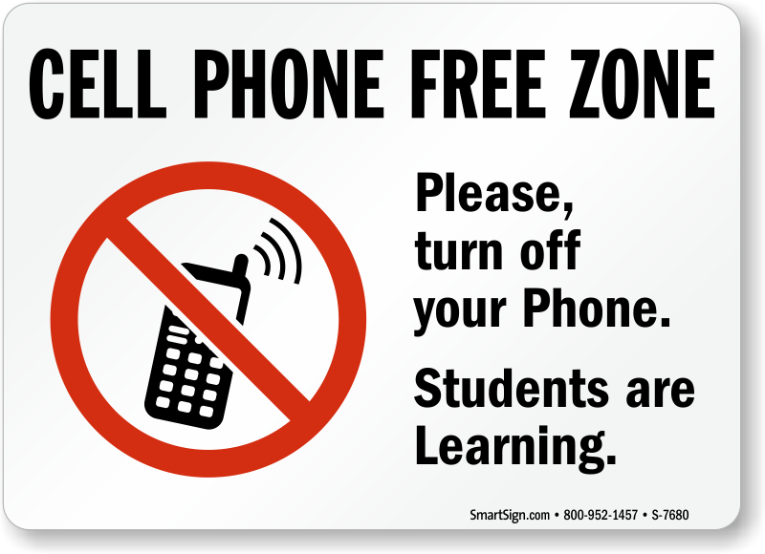

Slide 42
Textbook and Materials
www.dropbox.com
email:turkifib2014@yahoo.com
password:Istanbul2014

Slide 43
Grading System
Participation 10 %
Quizzes 10 %
Midterm Exam 25 %
Final Exam (Poster Exhibition) 25 %
Research Paper (Final Assesment) 30 %
(From Presentation and Class Discussion)

Slide 44
Research Paper (Final Assesment)
ABSTRACT AND KEYWORDS 200 WORDS
INTRODUCTION
RESEARCH METHOD AND METHODOLOGY
LITERATURE VIEW
FINDINGS
DISCUSSION
CONCLUSION
REFERENCES

Slide 45
5,500 – 6,000 WORDS
TIMES NEW ROMAN, 12
NO WORDPRESS
NO BLOGSPOT
NO KOMPASIANA
NO WIKIPEDIA
NO REPUBLIKA
JUST BOOKS, JOURNALS, PERIODICALS, ...

Slide 46
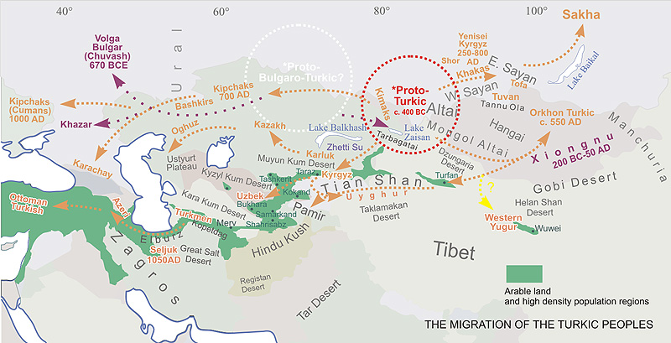

Slide 47
Week I 4 September 2018
Introduction: Syllabus
Who are the Turks?
Ethnicity and geography
The Migration of the Turkic People
The Turkish Language (https://www.youtube.com/watch?v=eJRQRD6LAmY)
Movie Screening East to West Between Two Rivers, BBC Documentation

Slide 48
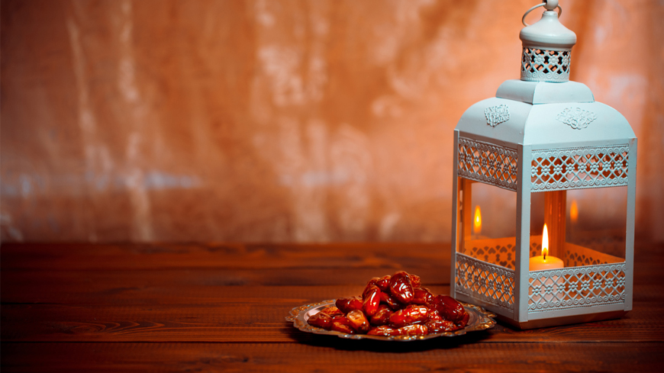
Week II
11 September 2018 (Islamic New Year)

Slide 49
Week III 18 September 2018 Turks in Eurasia (Europe and Central Asia)
I. The Turkish Dinasties before Islam in Central Asia
Hun Empire (221- 439)
Ak Hun State (367- 557)
Attila the Hun (406–453)
State of Göktürk (552-582 dan 685-754)
Uyghurs (745-840)
Oguz Türkleri (766-1000)
Orkhon Inscription, Bilge Kagan, Kul Tigin

Slide 50
II. Islam in Anatolia
Islam and the Turks
Opening of Anatolia to Islam
Mongol Occupation of Anatolia

Slide 51
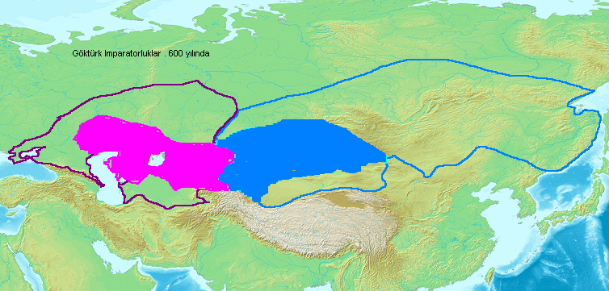
State of Göktürk (552-630)

Slide 52
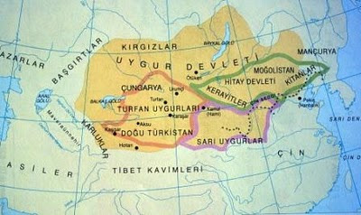
Uyghurs (745-840)

Slide 53
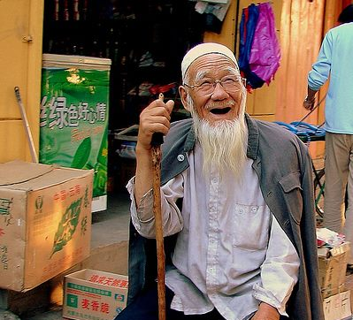
ORANG HUI (UYGHUR)
An ethnically Chinese Muslim. In China, ethnically Chinese Muslims are known as the Hui people/Uyghur

Slide 54
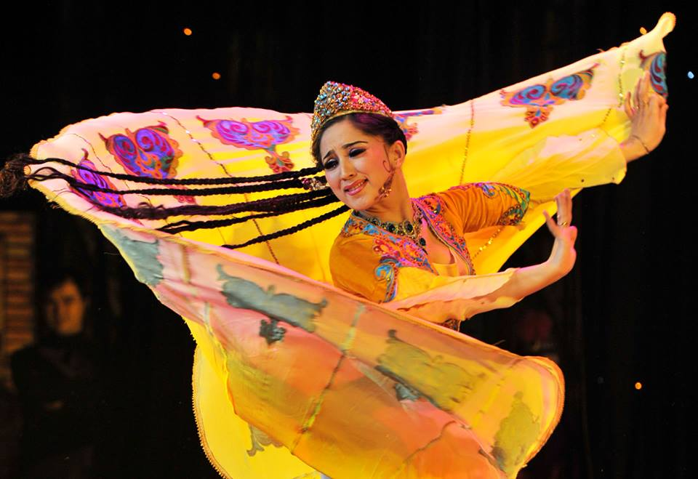

Slide 55
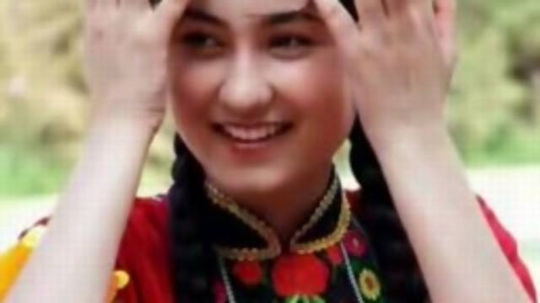

Slide 56
Week IV 25 September 2018 The 1st Islamic Turkic Dynasties
The Kharahanids (840-1212)
ALIVIA CINA
RIDHO FILSAFAT
FIKRI POLITIK
2. Tulunids in Egypt and Syria (868-905)
The architecture of Ahmed bin Tulun mosque
AMIRA POLITIK
RISKI ANITA KOMUNIKASI
QURROTA AYUNI KOMUNIKASI
Movie Screening East to West ‘The Triumph of Monotheism’, BBC Documentation

Slide 57
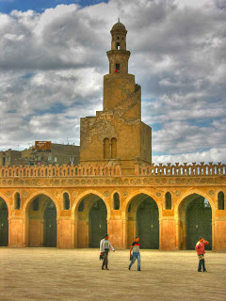
MENARA SPIRAL MASJID AHMAD BIN TULUN

Slide 58
Week V 2 October 2018 The 1st Islamic Turkic Dynasties
Ikhsidids in Egypt (935-969)
ANANDA PSIKO
KHUMAIRAH PSIKO
SUHA PSIKO
2. The Ghaznavid (936-1187)
HANIEF KOMUNIKASI
MARISA KOMUNIKASI
SEKAR KOMUNIKASI
Al-Mutanabbi
Ferdowsi, Shahnameh

Slide 59
Week VI 9 October 2018
1. The Great Seljukid Empire (1038-1194)
Manzikert War (1071)
The Battle of Dorylaeum (1 July 1097): The Seljuk Turks vs The Crusaders
The Battle of Harran (7 May 1104): The Seljuk Turks vs the Crusader states of the Principality of Antioch and the County of Edessa
The Battle of Sarmada (Field of Blood) 1119: The Turks vs French Crusaders
Nizamul Mulk: Siyasat Nameh
ADINDA JEPANG
TAZKIA JEPANG
AMANDA JEPANG
2. The Seljukid Sultanate of Rum (1077-1307)
AVE ARKEO
TIMMI JIP
Movie Screening East to West ‘A Force from the Dessert’ BBC Documentation

Slide 60
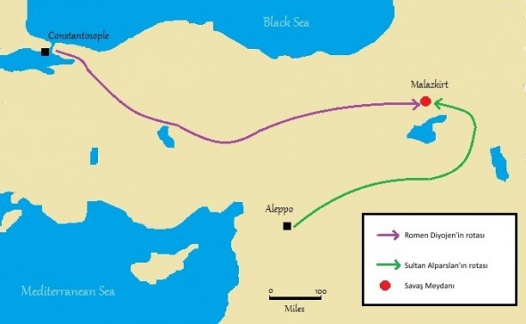

Slide 61
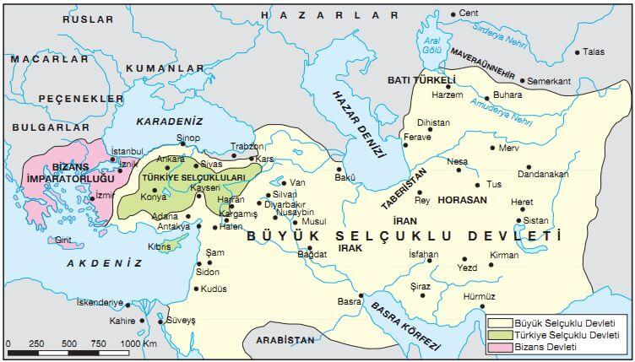

Slide 62
Week VII 16 October 2018 The Turkic Dynasties outside Turkey (Iran, Afghanistan and North India) and Confederation Turkic States
1. The Khwarazam Shahs (1077-1231)
HANI ARAB
SALMA ARAB
YELINDA INDONESIA
2. Il Khan in Persia (1256-1350)
BACHTIAR JERMAN
DONNY CINA
GRACE CINA

Slide 63
Week VIII 23 October 2018 The Mamluk Dynasty in Egypt and Syria (1250-1517)
Mamluk Bahri
SARI ANTROP
CYNTHIA CINA
YULI ANTROP
2.Mamluk Burji
Battle of Ain Jalut (2 September 1260): Mamluks vs the Mongols
RECKY JERMAN
MIRA HI
Movie Screening East to West ‘The Asian Crucible’ BBC Documentation

Slide 64

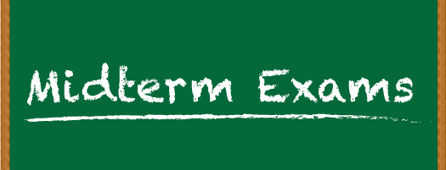
Week IX 6 November 2018

Slide 65
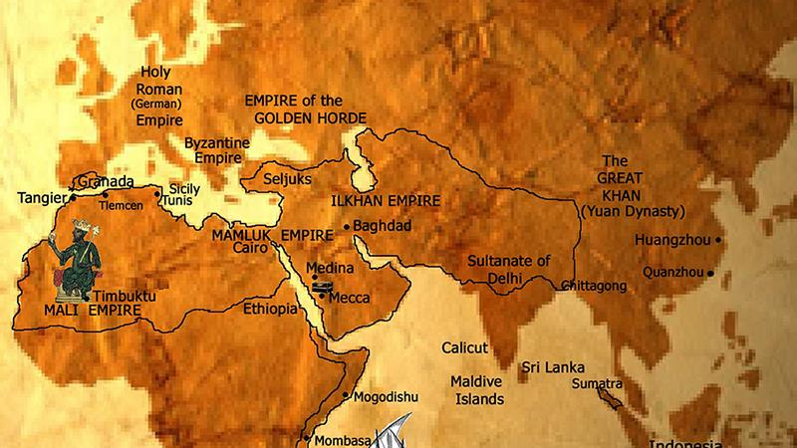

Slide 66
Week X 13 November 2018 The Confederation of Turkic States. Negara-negara Regional (Beylikler States)
The Timurid states (1370-1507)
ILHAM KOMUNIKASI
SYNDY KOMUNIKASI
REGITA POLITIK
2. Kara Koyunlu (1374-1468) dan Ak Koyunlu (1378-1505)
SAHLA JERMAN
ANTHEA CINA
KEZIA PERANCIS

Slide 67
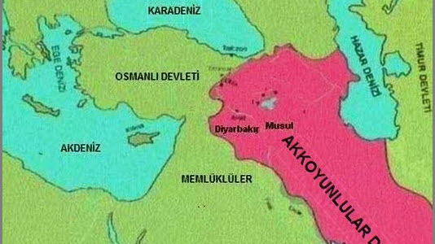

Slide 68
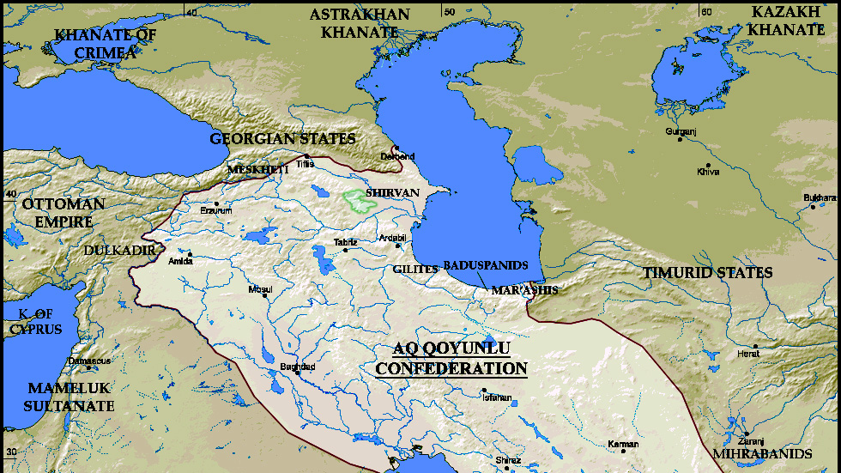

Slide 69
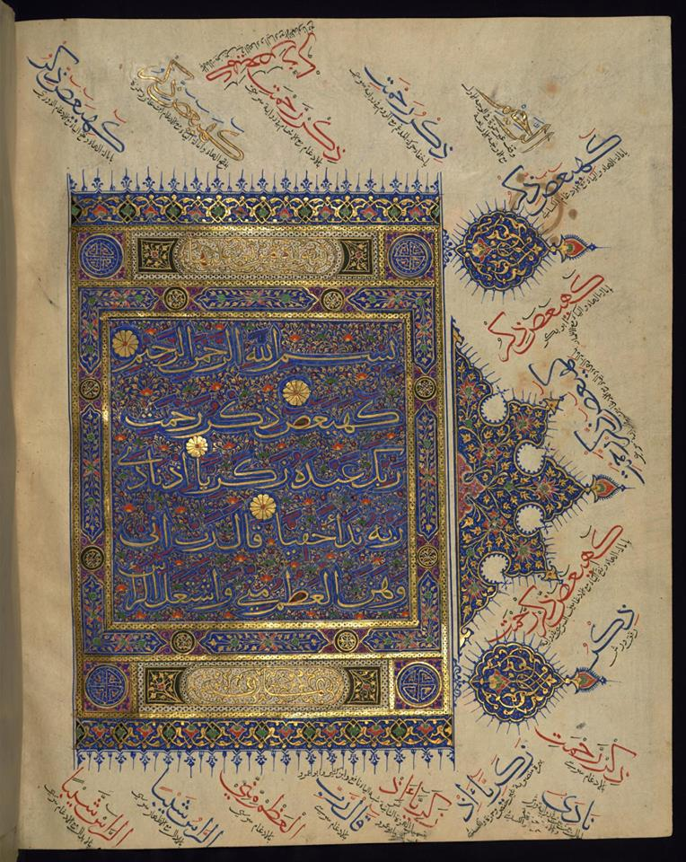
A Timurid era (1400s)
Copy of the Quran, copied in Northern India.
This page shows the first four verses of Surat Maryam.
In the margins are notes regarding pronunciation and meanings in Persia.

Slide 70
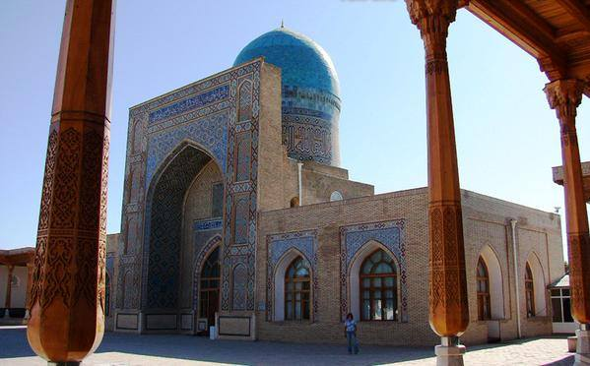
The Kok Gumbaz Mosque in Shahrisabz, Uzbekistan. Built by the Timurid Empire in 1437

Slide 71
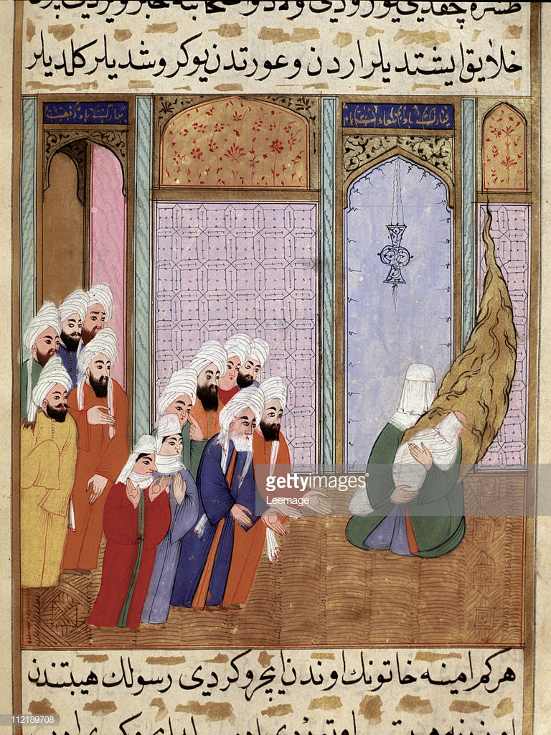
Week XI 20 November 2018
The Prophet Muhammad’s Birthday

Slide 72
Week XII 27 November 2018 The Turkish Dynasties Outside Turkey (Iran, Afghanistan and North India)
1.The Mughal Empire (1526-1857)
IMANUEL ELEKTRO
WELDALINE KOMPUTER
2.The Safevids (1501-1722)
ANGGA RUSIA
NABILA BELANDA
RAFI BELANDA

Slide 73
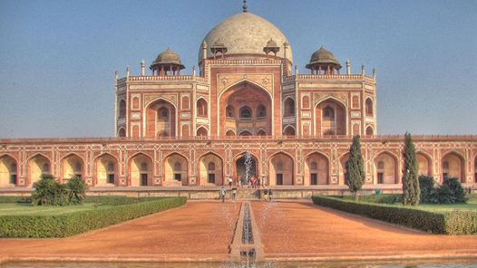
Makam Humayun di Aghra, Sultan Dinasti Mughal II, putra Babur, pendiri Dinasti Mughal di India dan ayah Sultan Akbar. Makamnya berfungsi pula sebagai mausoleum.

Slide 74
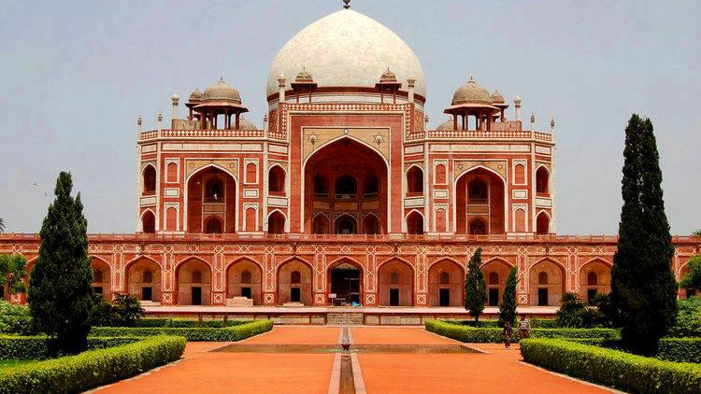

Slide 75
Dinasti Mughal didirikan oleh Babur, dari Ferghana (Tajikistan sekarang). Dari pihak ayah, dia keturunan Jenghis Khan dan dari pihak ibu keturunan Timur Lenk.
Keduanya adalah penakluk besar, dan musuh Islam. Tetapi keturunannya berbalik menjadi pembela dan pelindung Islam.

Slide 76

Ratu Ruqayya, istri Sultan Akbar.
Lukisan Mughal abad ke-18 M

Slide 77

Lukisan Mughal Abad ke-17 M

Slide 78

Calligraphic tile in the Wazir Khan Mosque in Lahore, Pakistan. Built in 1635 by the Mughal Empire.

Slide 79
PERNAH MAKAN NASI BRIYANI?

Slide 80


Slide 81

BAGAIMANA DENGAN NASI KEBULI?

Slide 82



Slide 83
Week XIII 4 December 2018
Ottoman State I 1300-1566
Classical Period: The Foundation of the Ottoman State (Osmanli Devleti)
Movie Screening East to West ‘The Rise of the Ottoman Empire’
HANIFAH PSIKO
ANISA PERPUS
RAIHANA JERMAN

Slide 84

Kosovo, Battle of (1389) Battle between forces of the Serbian prince Lazar and the Ottoman sultan Murad I

Slide 85
Berdirinya Negara Ottoman (Osmanli Devleti)
Masyarakat klasik pada masa awal Negara Ottoman.
Sistem pemerintahan pada masa Negara Ottoman dan peran militer tentara baru (Jeniseri)
Sultan Mehmet II
Penaklukan Konstantinopel
Sultan Sulaiman the Magnificent

Slide 86

Sultan Mehmet II (1432-1481)
Mehmet the Conqueror
Fatih Sultan Mehmed
This portrait of Mehmed II was painted by an Italian Christian, Gentile Bellini

Slide 87
JAMINAN KEAMANAN, TOLERANSI, BEBAS INTIMADI DAN KEKERASAN
"I, the Sultan Khan the Conqueror, hereby declare to the whole world that, The Bosnian Franciscans granted with this decree are under my protection. And I command that: No one shall disturb or give harm to these people and their churches! They shall live in peace in my state. No one shall insult, put in danger or attack these lives, properties, and churches of these people! By declaring this decree, I swear on my sword by the holy name of Allah who has created the ground and sky, Allah's prophet Mohammed, and 124,000 former prophets that; no one from my citizens will react or behave the opposite of this decree!"

Slide 88

SULEIMAN THE MAGNIFICENT (1494-1566)
CALIPH OF ISLAM
AMIR AL-MU’MININ
SULTAN OF THE OTTOMAN STATE
CUSTODIAN OF THE TWO HOLY MOSQUES

Slide 89
APA YANG DIKATAKAN OLEH HUMAYUN?
“Indeed Suleiman the magnificent, deserves to be called the only Emperor on earth “. Humayun had handed over an imperial letter to the departing Reis, acknowledging Sultan Suleiman as “ the Khalifa of the highest qualities and the adorner of the throne of Khalifa “, and sought the Sultans prayers for the success of his state.

Slide 90


Slide 91

SIAPA INI?

Slide 92

The dome of the Selimiye Mosque in Edirne, Turkey. Built in the 1570s by Ottoman architect Mimar Sinan, it is considered his masterpiece

Slide 93
Week XIV 11 December 2018
I. Ottoman State II 1566-1789: Beginning of the Weakness, Rejuvenation, Decline and Restoration
MUHLIS ARKEO
RAIHAN PSIKOLOGI
IMAM ELEKTRO
II.Ottoman State III 1789 – 1876 : Decline
ESA HI
ANJANI HI
MITA JEPANG

Slide 94

The Dissolution of the Ottoman Empire, 1807–1924

Slide 95
Perbedaan kondisi Eropa dan Dinasti Usmani
Revolusi Konstitusi 1876 Sultan Abdul Hamid II
Isu Pan-Islamisme
Masa-masa menurunnya kekuasaan Dinasti Usmani

Slide 96

Sultan Abdul Hamid II (1842-1918)
CALIPH OF ISLAM
AMIR AL-MU’MININ
SULTAN OF THE OTTOMAN STATE
CUSTODIAN OF THE TWO HOLY MOSQUES

Slide 97

Tughra Sultan Abdul Hamid II

Slide 98

FAREWELL TO THE LAST CALIPH

Slide 99

The Hala Sultan Mosque in Larnaca, Cyprus. It was built by the Ottomans in the 1700s

Slide 100
Week XV 17-18 December 2018
Finalterm Exam
Poster Exhibitions

Slide 101

Week XVI 25 December 2018

